Slide 1
Computer Organization & Architecture
Assembly Language
Chapter 7
Instructor: Dr. Baha Ihnaini

Slide 2
Human-Friendly Programming
Computers need binary instruction encodings...
0001110010000110
Humans prefer symbolic languages...
a = b + c
High-level languages allow us to write programs in clear, precise language that is more like English or math. Requires a program (compiler) to translage from symbolic language to machine instructions.
Examples: C, Python, Fortran, Java, ...
We will introduce C in Chapters 11 to 19.

Slide 3
Assembly Language: Human-Friendly ISA Programming
Assembly Language is a low-level symbolic language, just a short step above machine instructions.
Don't have to remember opcodes (ADD = 0001, NOT = 1001, ...).
Give symbolic names to memory locations -- don't have to do binary arithmetic to calculate offsets.
Like machine instructions, allows programmer explicit, instruction-level specification of program.
Disadvantage:
Not portable. Every ISA has its own assembly language. Program written for one platform does not run on another.

Slide 4
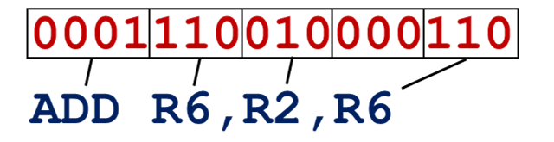
Assembly Language
Very similar format to instructions -- replace bit fields with symbols.
For the most part, one line of assembly language = one instruction.
Some additional features for allocating memory, initializing memory locations, service calls.
Numerical values specified in hexdecimal (x30AB) or decimal (#10).

Slide 5
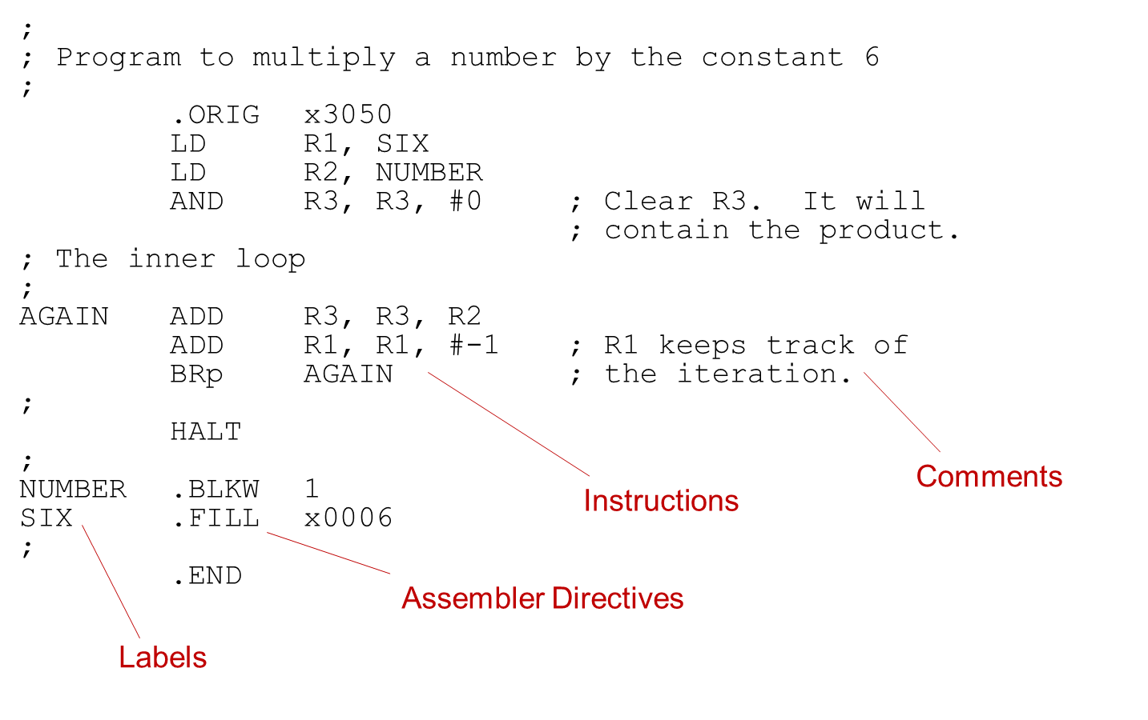
Example Program

Slide 6
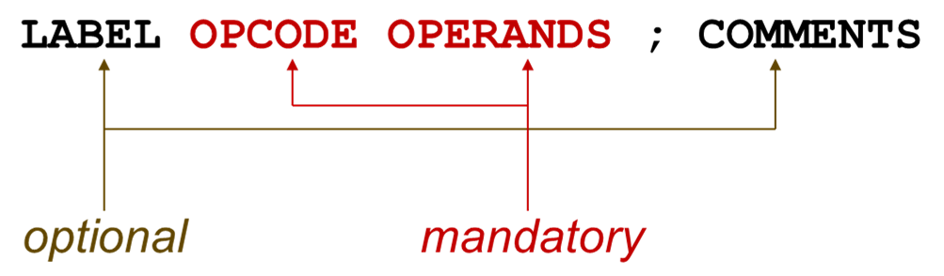
Assembly Language Syntax
Each line of a program is one of the following:
An instruction.
An assember directive (or pseudo-op).
A comment.
Whitespace (between symbols) and case are ignored.
Comments (beginning with “;”) are also ignored.
An instruction has the following format:

Slide 7
Mandatory: Opcode and Operands
Opcodes
Reserved symbols that correspond to LC-3 instructions.
Listed in Appendix A and Figure 5.3.
For example: ADD, AND, LD, LDR, …
reserved means that it cannot be used as a label
Operands
Registers -- specified by Rn, where n is the register number.
Numbers -- indicated by # (decimal) or x (hex).
Label -- symbolic name of memory location.
Separated by comma (whitespace ignored).
Number, order, and type correspond to instruction format.
ADD R1,R1,R3 ; DR, SR1, SR2 ADD R1,R1,#3 ; DR, SR1, Imm5 LD R6,NUMBER ; DR, address (converted to PCoffset) BRz LOOP ; nzp becomes part of opcode, address

Slide 8
Optional: Label and Comment
Label
Placed at the beginning of the line.
Assigns a symbolic name to the address corresponding to that line.
LOOP ADD R1,R1,#−1 ; LOOP is address of ADD BRp LOOP
Comment
A semicolon, and anything after it on the same line, is a comment.
Ignored by assembler.
Used by humans to document/understand programs.
Tips for useful comments:
Avoid restating the obvious, as “decrement R1.”
Provide additional insight, as in “accumulate product in R6.”
Use comments and empty lines to separate pieces of program.

Slide 9
Assembler Directive
Pseudo-operation
Does not refer to an actual instruction to be executed.
Tells the assembler to do something.
Looks like an instruction, except "opcode" starts with a dot.
Opcode | Operand | Meaning
.ORIG | address | starting address of program
.END |  | end of program
.BLKW | n | allocate n words of storage
.FILL | n | allocate one word, initialize with value n
.STRINGZ | n-character string | allocate n+1 locations, initialize w/characters and null terminator

Slide 10
Sample Program: Counting Occurrences in a File
Once again, we show the program that counts the number of times (up to nine) a user-specified character appears in a file.

Slide 11
Assembly Language Program 1
;
; Program to count occurrences of a character in a file.
; Character to be input from the keyboard.
; Result to be displayed on the monitor.
; Program only works if no more than 9 occurrences are found.
;
;
; Initialization
;
.ORIG x3000
AND R2, R2, #0 ; R2 is counter, initially 0
LD R3, PTR ; R3 is pointer to characters
TRAP x23 ; R0 gets character input
LDR R1, R3, #0 ; R1 gets first character
;
; Test character for end of file
;
TEST ADD R4, R1, #-4 ; Test for EOT (ASCII x04)
BRz OUTPUT ; If done, prepare the output
;
; Test character for match. If a match, increment count.
;
NOT R1, R1
ADD R1, R1, #1
ADD R1, R1, R0 ; Compute R0-R1 to compare
BRnp GETCHAR ; If no match, do not increment count
ADD R2, R2, #1

Slide 12
Assembly Language Program 2
;
; Get next character from file.
;
GETCHAR ADD R3, R3, #1 ; Point to next character.
LDR R1, R3, #0 ; R1 gets next char to test
BRnzp TEST
;
; Output the count.
;
OUTPUT LD R0, ASCII ; Load the ASCII template
ADD R0, R0, R2 ; Covert binary count to ASCII
TRAP x21 ; ASCII code in R0 is displayed.
TRAP x25 ; Halt machine
;
; Storage for pointer and ASCII template
;
ASCII .FILL x0030
PTR .FILL x4000
.END

Slide 13
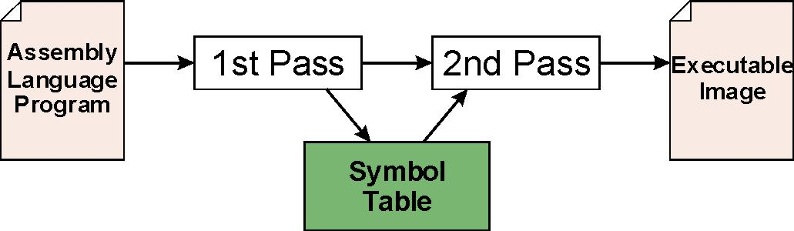
Assembly Process
The assembler is a program that translate an assembly language (.asm) file to a binary object (.obj) file that can be loaded into memory.
First Pass:
Scan program file, check for syntax errors.
Find all labels and calculate the corresponding addresses: the symbol table.
Second Pass:
Convert instructions to machine language, using information from symbol table.

Slide 14
First Pass: Construct the Symbol Table
Find the .ORIG statement, which tells us the address of the first instruction.
Initialize location counter (LC), which keeps track of the current instruction.
For each non-empty line in the program:
If line contains a label, add label and LC to symbol table.
Increment LC.
NOTE: If statement is .BLKW or .STRINGZ, increment LC by the number of words allocated.
Stop when .END statement is reached.
NOTE: A line that contains only a comment is considered an empty line.

Slide 15
First Pass on Sample Program (Comments Removed)
-- .ORIG x3000
x3000 AND R2, R2, #0
x3001 LD R3, PTR
x3002 TRAP x23
x3003 LDR R1, R3, #0
x3004 TEST ADD R4, R1, #-4
x3005 BRz OUTPUT
x3006 NOT R1, R1
x3007 ADD R1, R1, #1
x3008 ADD R1, R1, R0
x3009 BRnp GETCHAR
x300A ADD R2, R2, #1
x300B GETCHAR ADD R3, R3, #1
x300C LDR R1, R3, #0
x300D BRnzp TEST
x300E OUTPUT LD R0, ASCII
x300F ADD R0, R0, R2
x3010 TRAP x21
x3011 TRAP x25
x3012 ASCII .FILL x0030
x3013 PTR .FILL x4000
-- .END
Label | Address
TEST | x3004
GETCHAR | x300B
OUTPUT | x300E
ASCII | x3012
PTR | x3013

Slide 16
Second Pass: Convert to Machine Instructions
Find the .ORIG statement, which tells us the address of the first instruction.
Initialize location counter (LC), which keeps track of the current instruction.
For each non-empty line in the program:
If line contains an instruction, translate opcode and operands to binary machine instruction. For label, lookup address in symbol table and subtract (LC+1). Increment LC.
If line contains .FILL, convert value/label to binary. Increment LC.
If line contains .BLKW, create n copies of x0000 (or any arbitrary value). Increment LC by n.
If line contains .STRINGZ, convert each ASCII character to 16-bit binary value. Add null (x0000). Increment LC by n+1.
Stop when .END statement is reached.

Slide 17
Errors during Code Translation
While assembly language is being translated to machine instructions, several types of errors may be discovered.
Immediate value too large -- can't fit in Imm5 field.
Address out of range -- greater than LC+1+255 or less than LC+1-256.
Symbol not defined, not found in symbol table.
If error is detected, assembly process is stopped and an error message is printed for the user.

Slide 18
Beyond a Single Object File
Larger programs may be written by multiple programmers, or may use modules written by a third party. Each module is assembled independently, each creating its own object file and symbol table.
To execute, a program must have all of its modules combined into a single executable image.
Linking is the process to combine all of the necessary object files into a single executable.

Slide 19
External Symbols
In the assembly code we're writing, we may want to symbolically refer to information defined in a different module.
For example, suppose we don't know the starting address of the file in our counting program. The starting address and the file data could be defined in a different module.
We want to do this:
PTR .FILL STARTofFILE
To tell the assembler that STARTofFILE will be defined in a different module, we could do something like this:
.EXTERNAL STARTofFILE
This tells the assembler that it's not an error that STARTofFILE is not defined. It will be up to the linker to find the symbol in a different module and fill in the information when creating the executable.

